Slide 1
WRITE THE FACTORIAL OF A NUMBER USING RECURSION
Step 1: Start
Step 2: Read a number n
Step 2: Initialize variables:
i = 1, fact = 1
Step 3: if i <= n go to step 4 otherwise go to step 7
Step 4: Calculate
fact = fact * i
Step 5: Increment the i by 1 (i=i+1) and go to step 3
Step 6: Print fact
Step 7: Stop

Slide 3
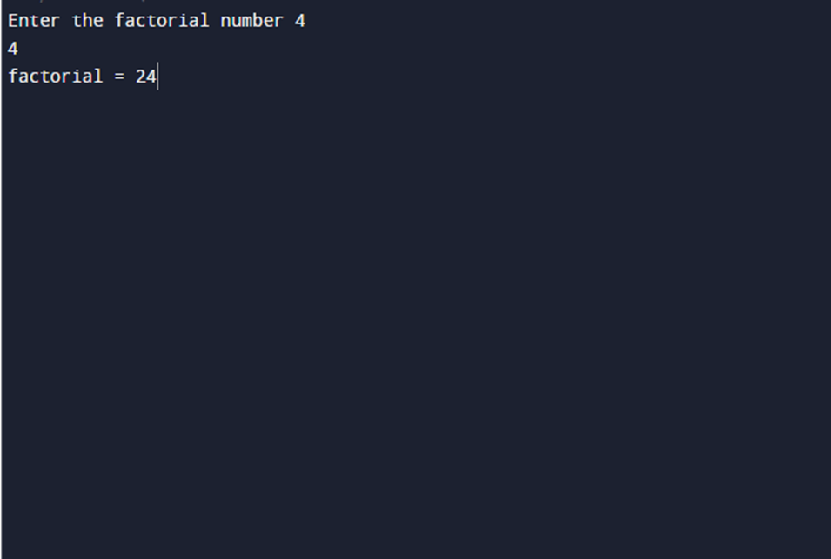
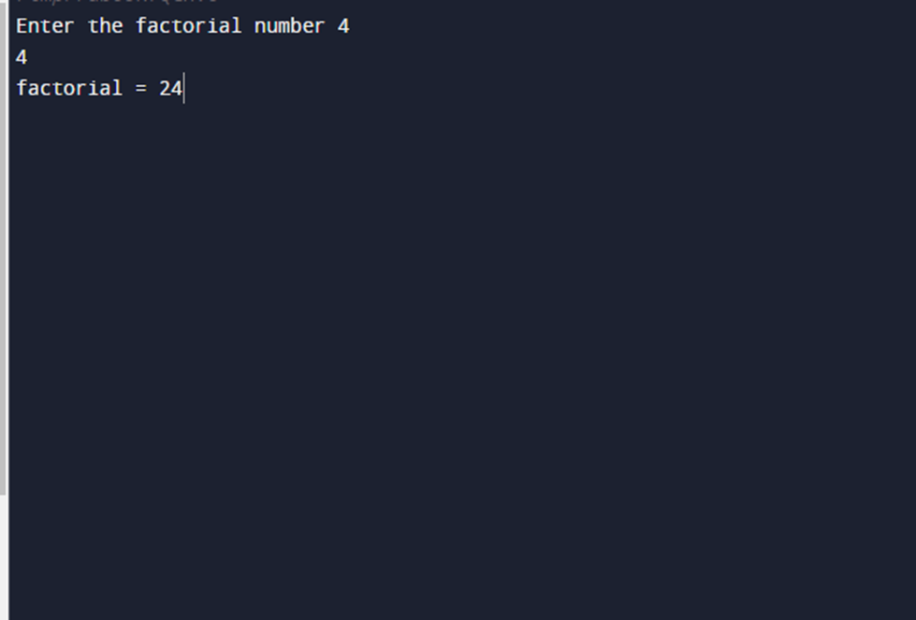
OUTPUT:

